Slide 1
Intro To Programming JavaScript

Slide 2
Brief Summary Of Chapter 3
What is an Array
Using Math.random and Math.floor
Creating a Random Insult Generator
Chapter 3: Arrays

Slide 3
An array is a data structure that holds a collection of elements, typically of the same type, in a specific order. Each element in an array can be accessed by its index, which is a numeric value representing its position in the array.
Arrays are useful because they allow you to store multiple values in a single variable. Easily access and manipulate elements based on their position and perform operations on groups of data efficiently.
You can create an array in JavaScript using square brackets []
E.g. var fruits = ['apple', 'banana', 'cherry'];
What is an Array?

Slide 4
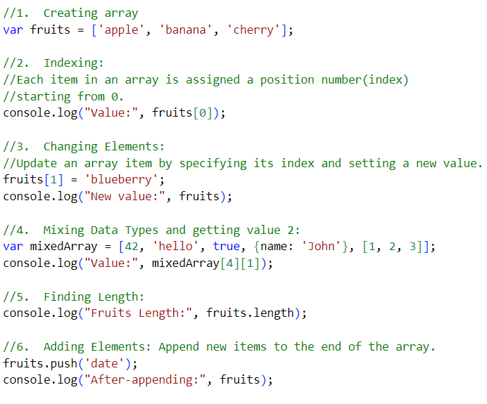
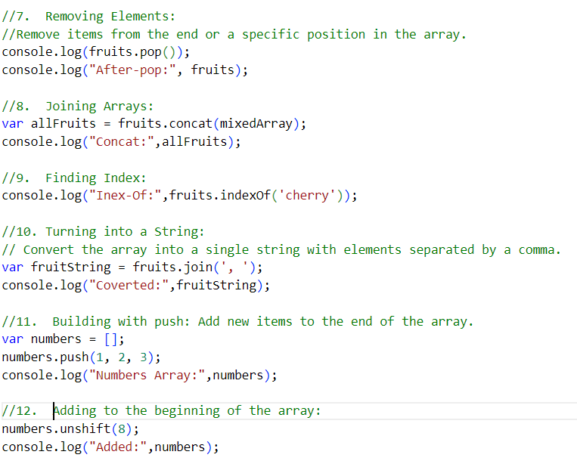
Essential Array Operations Indexing, Modifying, and Managing Data

Slide 5

Math.random() generates a random number between 0 and 1. This number can be used for various purposes, like randomizing selections or creating random values.
Math.floor() takes a number and rounds it down to the nearest whole number. This is useful when you want to ensure that a value is an integer and does not exceed a certain threshold. JavaScript uses Math.floor() to convert a floating-point number from Math.random() into an integer, ensuring a valid array index.
Example: B-85 & L-58
This code is selecting a random word from the randomWords array by generating a random index between 0 and 3 (inclusive).
Using Math.random and Math.floor

Slide 6
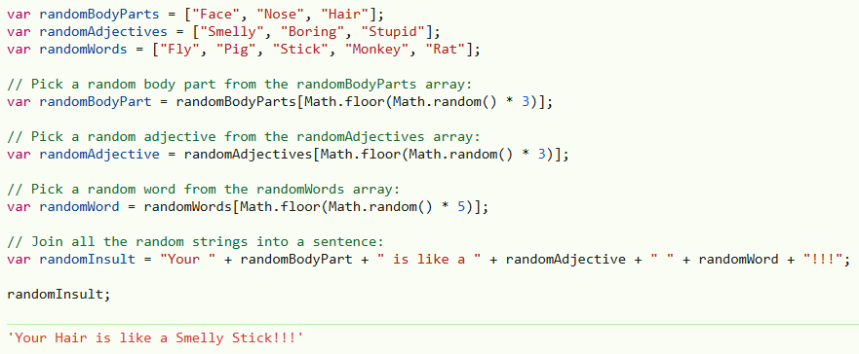
(B-p86 & L-p 59)
Creating a Random Insult Generator

Slide 7

Do all the try outs and programming challenges then upload to github.
Page (B-87 & L-60)
Page (B-88 & L-61)
Practice Exercises

Slide 8
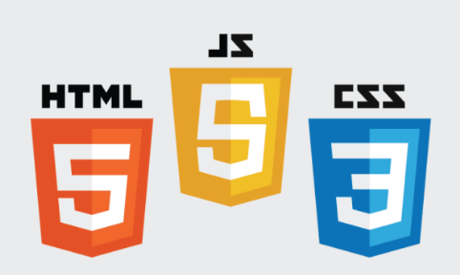
End Of Chapter 3

